Slide 1
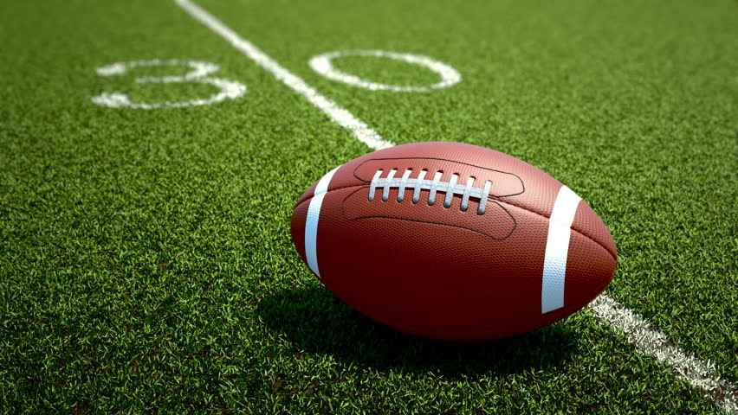
American Football: An Analytical Approach
The Best Group: Lavada Blanton, Aaron Carmichael, Levi Taylor, and Robert Underwood

Slide 2
Business Understanding
Where is the money?
In 2018, the NFL generated $15 billion.
https://www.chicagotribune.com/sports/football/ct-spt-nfl-revenue-super-bowl-20190128-story.html
103.3 Million viewers for the 2017 Super Bowl.
Large revenue stream for commercial airtime.
More Touchdowns = More Wins = More $$$$.

Slide 3
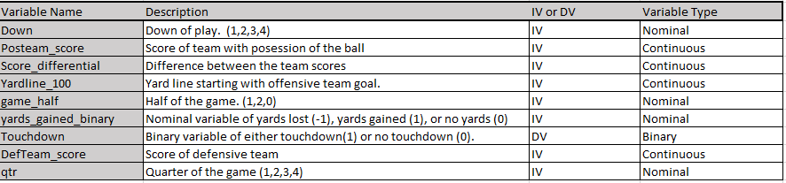
Data Understanding
228030 Observations

Slide 4
Data Preparation
Variable Selection
Variable Analysis
Imputation
Omitting Irrelevant Data.
Variable Adjustment

Slide 5
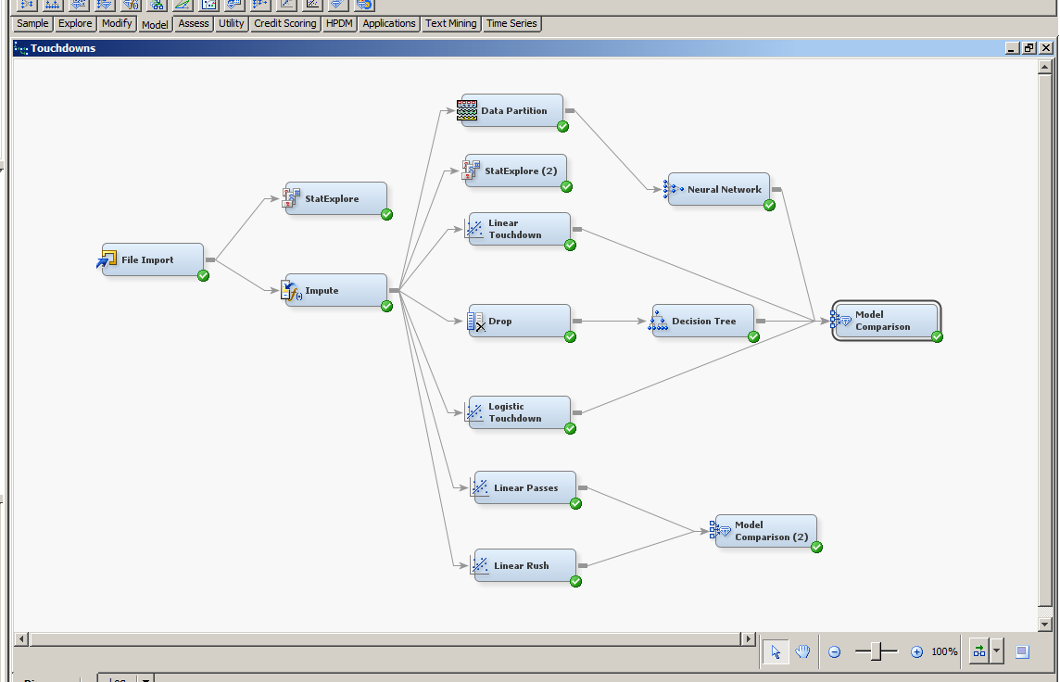
Modeling

Slide 6
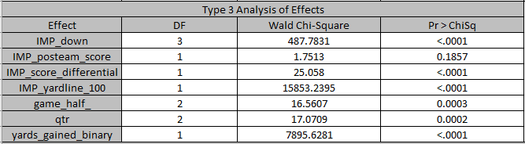
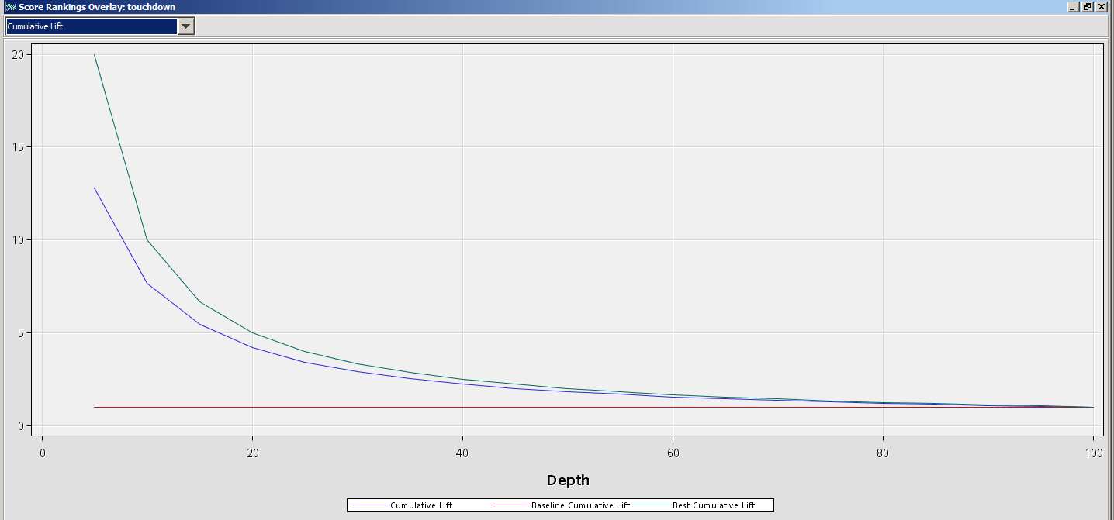
Modeling
Logistic Regression
Significance
Lift
0.38 at 20 Depth
Misclassification
0.03

Slide 7
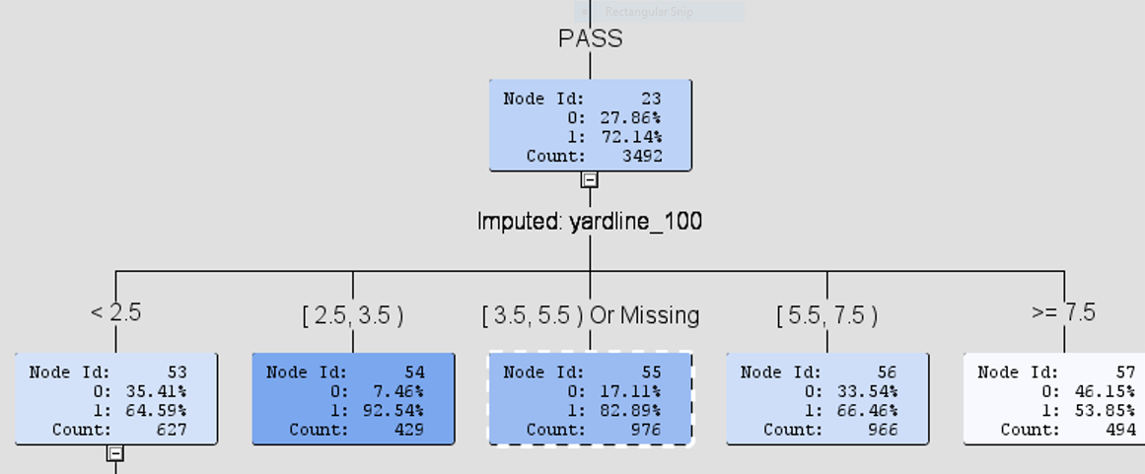
Modeling
Decision Trees
When a team is 2.5-3.5 yards away from goal line the percentage of scoring a touchdown with a pass is 92.54%.

Slide 8
Modeling
Passing Linear Regression
Air_yards
Pass_length
Yards_after_catch
R^2 = .9987
Rushing Linear Regression
IMP_down
IMP_score_differential
IMP_yardline_100
Defteam_timeouts_remaining
Posteam_timeouts_remaining
Qtr
Ydstogo
R^2 = .0577

Slide 9
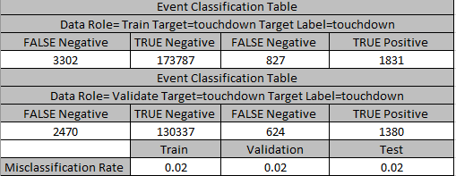
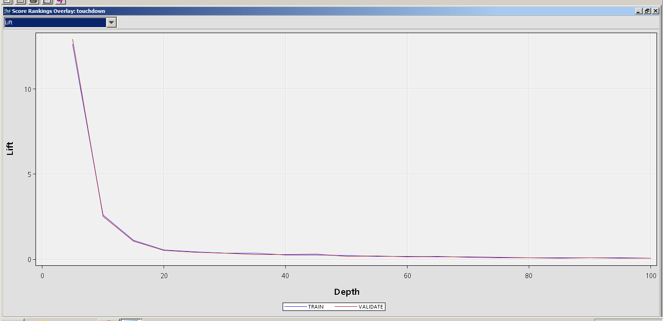
Modeling
Neural Network
Misclassification Rate
0.02
Lift
1.32 at 20 depth

Slide 10
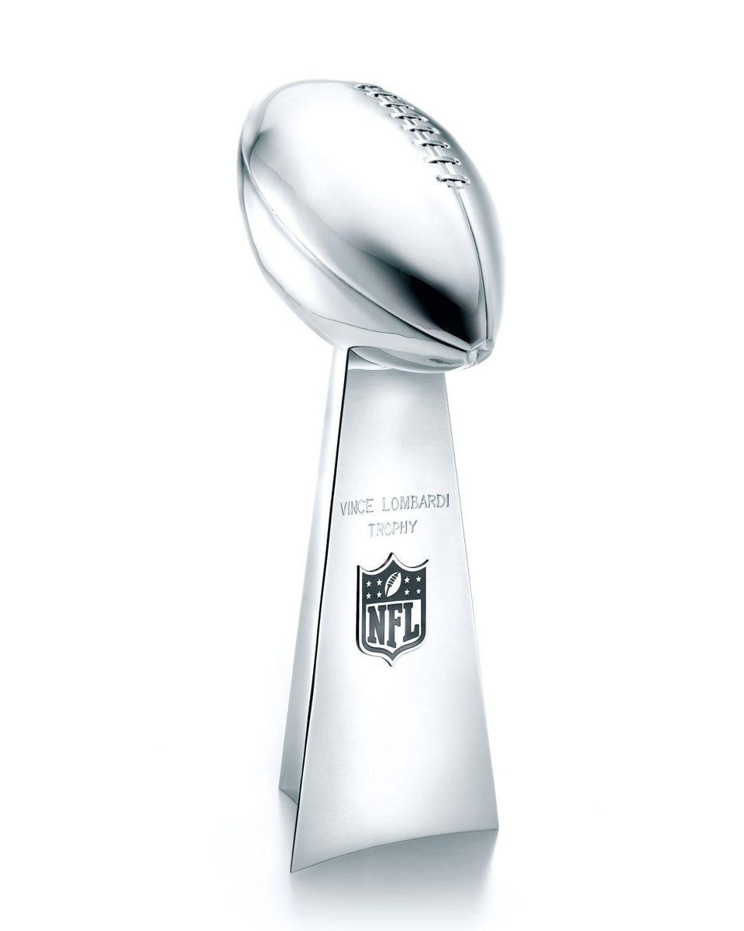
Evaluation & Conclusion
Touchdown predictions are unreliable
Human variables make play results unpredictable
Whats next?
Analysis of Possession Data
Focus on Player Development & Statistics

